Slide 1
Enterprise Architectures
BS42, Lesson 1
Samuil Angelov

Slide 2

Image source: http://www.noelkingsley.com/blog/archives/2007/01/post_84.html

Slide 3
Disambiguation
BS42 – this course: Architecture of the enterprise (enterprise=organization). Role of the software applications in the organization.
EA7 - Software architectures spanning across the enterprise; focus on middleware messaging.
JEA61 - Java Enterprise Applications

Slide 4
Course setup
On sharepoint:
Slides
Additional study materials (optional but very useful)
Course setup
Assignment and case (SMES)
Working case (BookOnline)

Slide 5
Lesson 1
Architecture - definition
Introduction to Enterprise Architectures:
Definition
Goals
Elements
What are Views?
What are Aggregation levels?
Archimate
Cases SMES and BookOnline – an introduction

Slide 6
Architectures
From Software to Enterprise Architectures

Slide 7


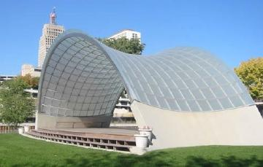
Architecture
Image sources:
http://thezeroboss.com/best-family-destinations-in-spain-calpe-malaga-alicante-valencia/
http://libpress.colorado.edu/?p=622
http://www.tcdailyplanet.net/article/2008/11/19/has-there-been-any-decent-architecture-st-paul-last-30-years.html

Slide 8
Architecture
“An architecture is the fundamental organization of a system, embodied in its components, their relationships to each other and the environment and the principles governing its design and evolution.”
Architecture description vs architecture
Software architecture (GSO31/GSO 32)
Types of architectures (and architects)

Slide 9
What is Enterprise Architecture?
Conceptual blueprint that defines the structure and operation of an enterprise and its information systems
Description of the goals of an organization, how these goals are realized by business processes, and how the business processes can be better served through technology

Slide 10
Goals of Enterprise Architectures
To provide a common basis for understanding and communicating how systems are structured to meet strategic objectives
To provide a balanced approach to the selection, design, development and deployment of all the solutions to support the enterprise
To allow stakeholders to prioritize and justify often conflicting technology trade-off decisions based on the bigger picture
To lead to consolidation and simplification; more disciplined approaches to system planning, funding and development; better risk management with fewer false starts

Slide 11
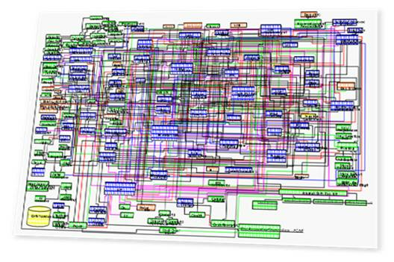
How to represent an Enterprise Architecture?
Representing all elements of an enterprise and the relationships between them in one model is not possible.
Solution – use views, use aggregation levels
Source IBM

Slide 12
Aggregations of models
(student version: “zooming in”)

Slide 13
Aggregation of models
Often, one view can be represented in different levels of detail (aggregation levels).
Higher aggregation levels are easier to understand and grasp but are less informative
Lower aggregation levels are more complex, perhaps depicted in several diagrams (to reduce complexity) but more informative about details.

Slide 14
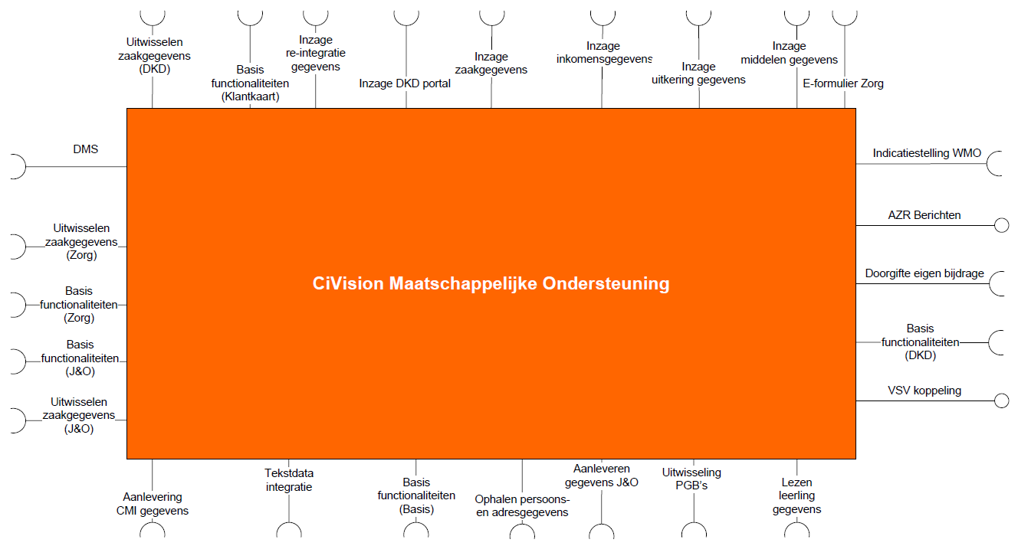
An example – level 1
Source: http://alexandria.tue.nl/extra1/afstversl/wsk-i/sauve2010.pdf

Slide 15
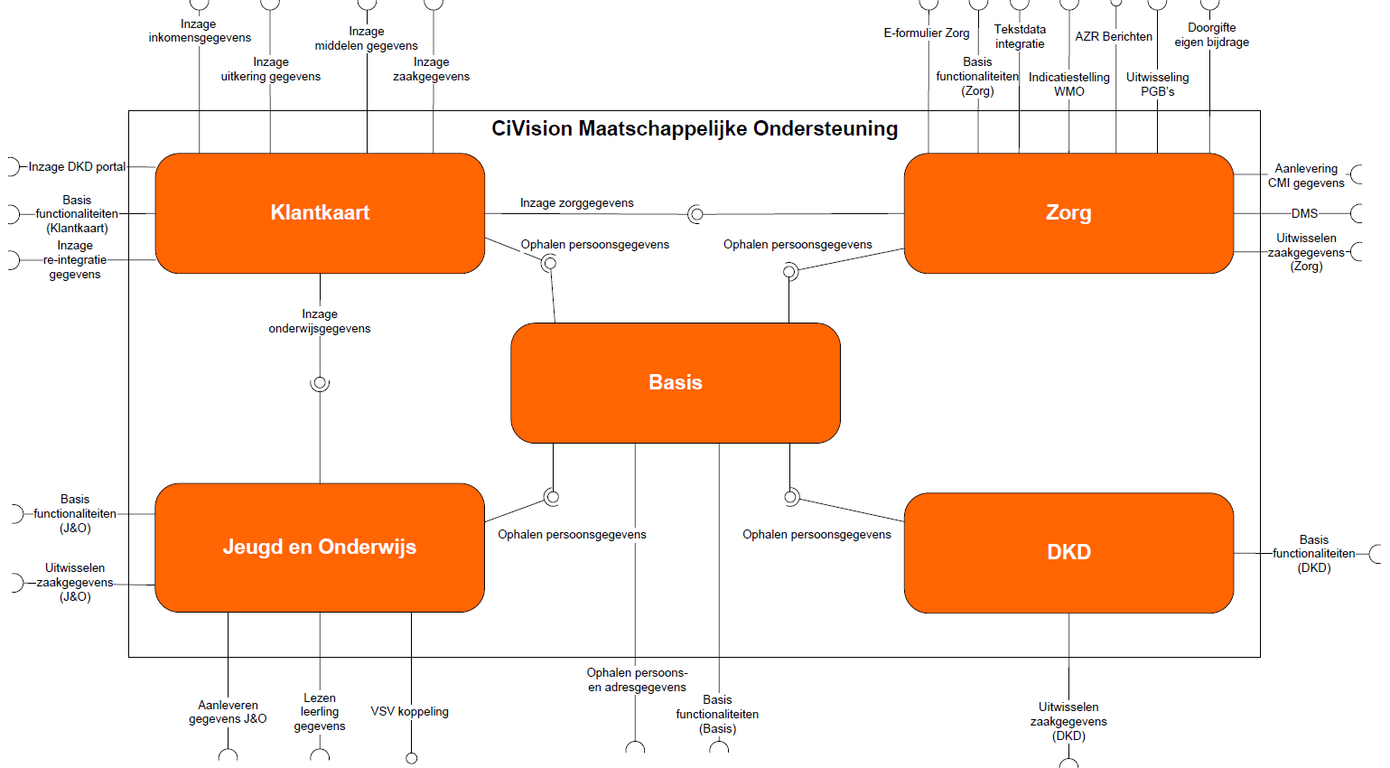
An example – level 2
Source: http://alexandria.tue.nl/extra1/afstversl/wsk-i/sauve2010.pdf

Slide 16
Architecture views

Slide 17
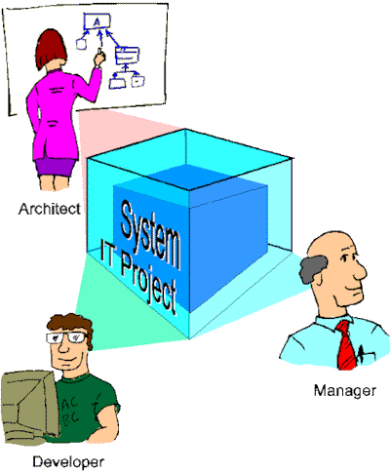
Architecture views
Architecture views are representations of the overall architecture that contain information relevant for one or more stakeholders.
A viewpoint defines the
perspective from which
a view is taken.
The architects decides which
Viewpoints are needed
and elaborates the views.

Slide 18
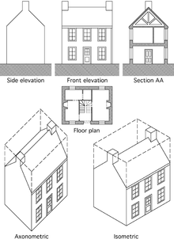
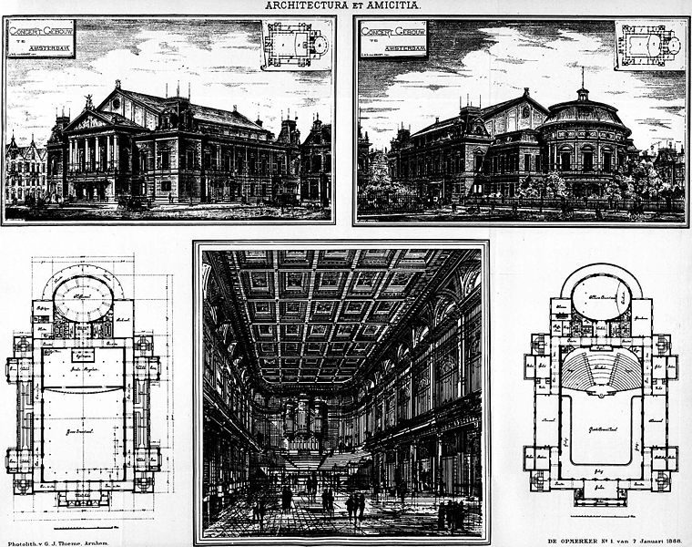
Analogy
Depending on the view stakeholders, in each view, we decide on what we want to focus and what is not important (so it can be ignored).
http://en.wikipedia.org/wiki/Architectural_drawing

Slide 19
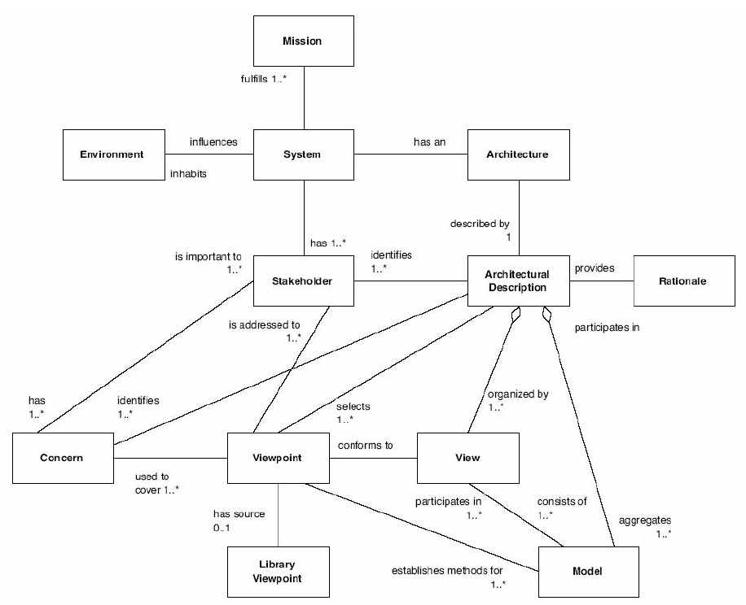
ISO/IEC 42010:2007, Systems and Software Engineering – Recommended Practice
for Architectural Description of Software-Intensive Systems

Slide 20
Viewpoints in software architectures – Kruchten 4+1
Use Case diagrams
User requirements
Activity diagrams
Class/object diagrams Communication diagrams
Logical View
Process View
Use Case View
Physical View
DevelopmentView
Deployment diagrams
Package diagrams
Component diagrams
Who are the different stakeholders here?

Slide 21
Viewpoints in Enterprise Architectures
Define part of the enterprise form the perspective of one or more stakeholders of the enterprise.
Generic stakeholders:
Managers
Business people
Software people
Technology people
Levels are a common technique in EA to represent the viewpoints of these stakeholders on an enterprise. Within a level, views can be again defined (there are different managers, business and software people).

Slide 22
For example
The Business Layer offers products and services to external customers, which are realized in the organization by business processes performed by business actors.
The Application Layer supports the business layer with application services which are realized by (software) applications.
The Technology Layer offers infrastructure services (e.g., processing, storage, and communication services) needed to run applications, realized by computer and communication hardware and system software.

Slide 23
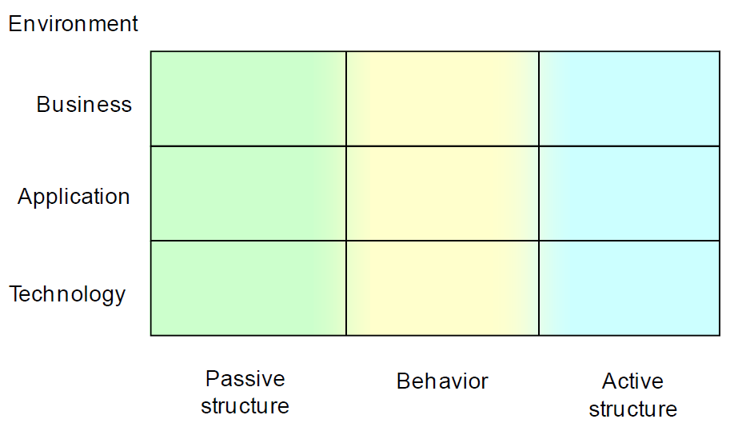
For example
Levels (main viewpoints)
Sub-viewpoints within a level

Slide 24
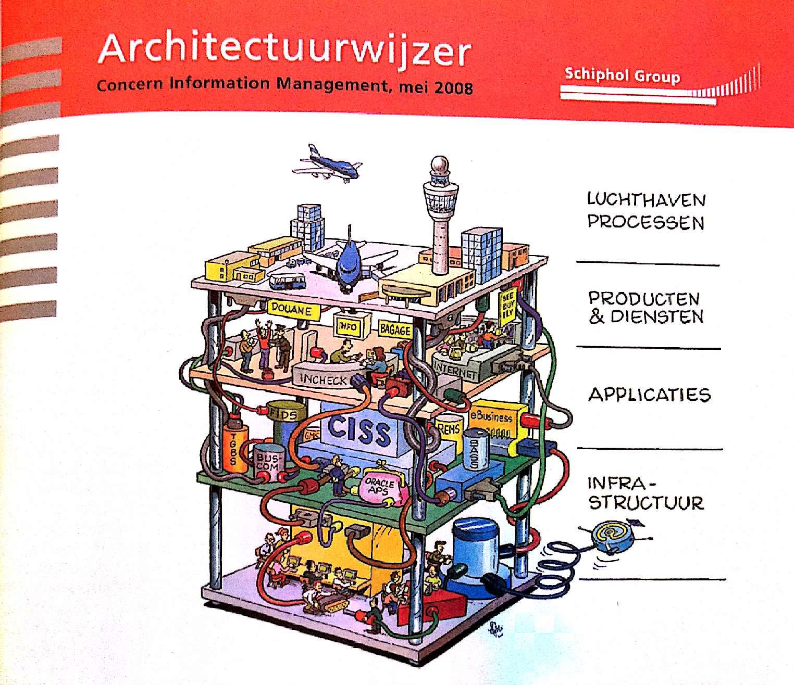

Slide 25
Creating views
1. Refer to an existing library of viewpoints. See also lesson 4. What if a viewpoint library does not exist?
2. Select the appropriate viewpoints (based on the stakeholders concerns).
3. Generate views of the system by using the selected viewpoints as templates.

Slide 26
The Open Group Architectural Framework
Archimate

Slide 27

Archimate
Archimate is a framework + language + notation for EA modelling.
Originated during a project at Telematica Instituut in cooperation with several Dutch partners from government, industry and academia.
Now embraced by the Open Group. V 2.0 – 2012
To be merged with TOGAF
(method + notation = complete toolset)
http://www.opengroup.org/subjectareas/enterprise/archimate

Slide 28
Framework

Slide 29
Viewpoints in Archimate
ArchiMate advocates a more flexible approach in which architects and other stakeholders can define their own viewpoints on the enterprise architecture.
A list of standard viewpoints is provided (based on practical experience).
Some of these viewpoints have a scope that is limited to a single layer or aspect. Other viewpoints link multiple layers and/or aspects.

Slide 30
Some viewpoints in Archimate
Product
Process cooperation
Organization
Information
Business process
Application usage
Application co-operation
Application behavior
Application structure
Implementation and
deployment
Infrastructure

Slide 31
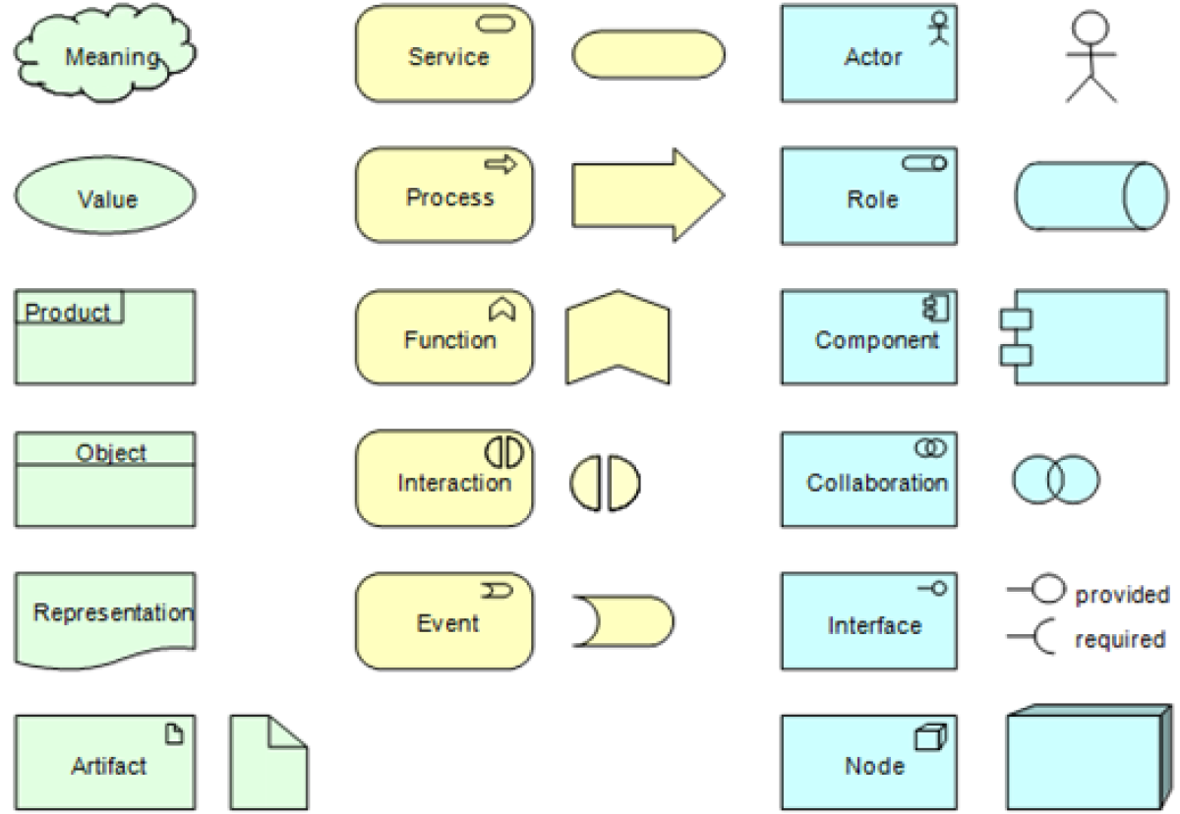
Core concepts

Slide 32
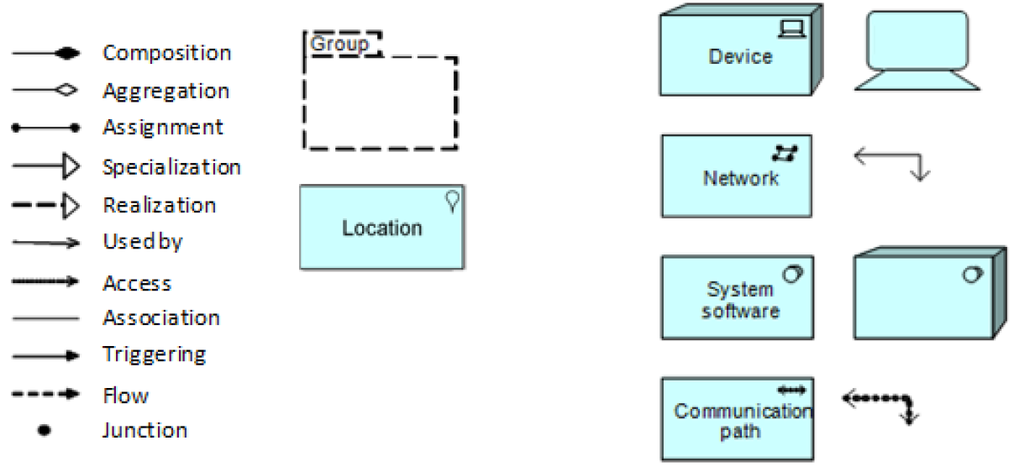
Core concepts
Colors in Archimate: Colors are only supporting – not part of the standard.
Blue is associated with applications, yellow with business, and green with technology. Extensions in v2.0 are purple.

Slide 33
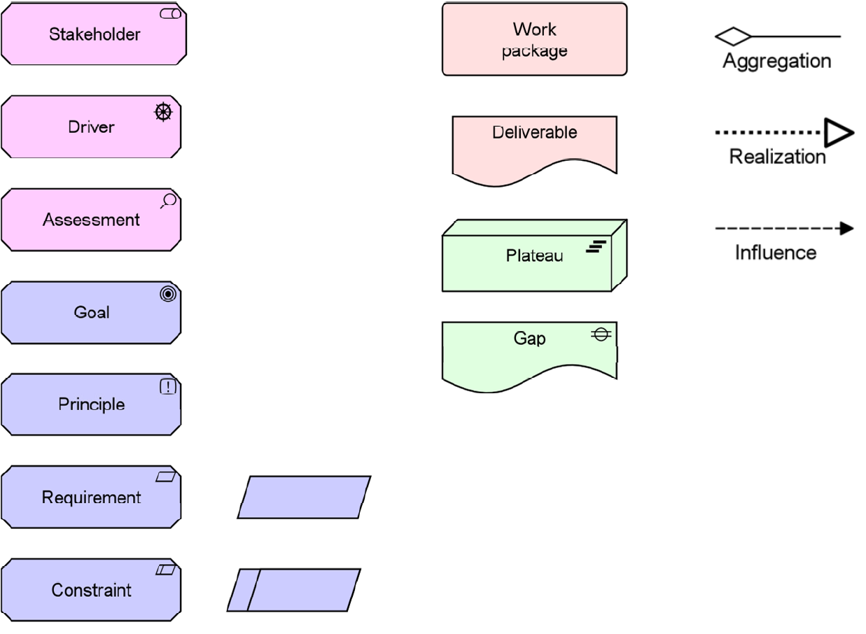
Extensions (samples)

Slide 34
Strengths of Archimate
Holistic language
Has constructs that allow modeling of relationships between the “standard” viewpoints of the frameworks, i.e., several aspects can be modeled in one view
As a result, one can model relations between processes and people, between applications and people, processes and data, etc.
- contrary to UML (where the possible viewpoints are predefined by the possible diagram techniques), Archimate can be used to model new, context-specific viewpoints

Slide 35
Conclusions on Archimate
Archimate is a language/notation (like UML)
Archimate is relatively young
Provides currently unique, holistic EA notation
Free viewpoint selection/definition
Supports modeling of relationships between the “standard” viewpoints of the frameworks

Slide 36
EA in this course

Slide 37
EA and you
Software engineers would not normally develop a complete EA model.
We teach you to:
Understand the concept of EA
Have knowledge about EA frameworks and notations
Be able to make simple enterprise models
As a result, you will be able to understand and model how IT applications relate to the enterprise (company). This understanding is important for SE.

Slide 38
Approach
To achieve our goals, in this course, we make simple models.
Information for the models is given in the SMES case description.
The SMES case is based on a large Dutch enterprise.

Slide 39
Cases introduction
SMES
Book Online

